Slide 1
Benchmarking TeraSort Performance Hadoop & Spark on Docker vs JetStream 2
Cloud Computing From Docker Simulations to Real Cloud

Slide 2
Motivation
Distributed frameworks like Apache Hadoop and Apache Spark are widely used for large-scale data processing.
Performance scaling on different platforms (e.g., cloud vs containerized environments) is critical, but often non-intuitive due to hidden infrastructure bottlenecks.
Benchmarking basic workloads like TeraSort provides valuable insights into real-world system behavior beyond theoretical models.
Through benchmarking TeraSort on different platforms, with increasing number of nodes, helps us understand behaviours on small data
Improves our empirical insights on Cloud Computing
Notes:
Data-driven world “As you know, modern organizations from finance to healthcare increasingly depend on insights drawn from massive datasets. Whether it’s user-behavior logs or scientific measurements, the first step in many analytics pipelines is sorting and preparing data efficiently.”
Frameworks: Hadoop vs. Spark “Two of the most widely adopted frameworks for big-data processing are Hadoop and Spark. Hadoop’s MapReduce writes intermediate data to disk, which can be robust for huge workloads. Spark, on the other hand, keeps data in memory for faster iterative processing—but at the cost of larger memory requirements.”
Why platform choice matters “Choosing between these frameworks isn’t just an academic exercise. Real-world factors like network bandwidth, storage I/O, and available memory can tip the scales dramatically. What runs fast on one cluster topology may become the bottleneck on another.”
TeraSort benchmark “TeraSort is a classic, end-to-end sorting benchmark that stresses every layer of the data path: input generation, shuffle across the network, sorting in memory or on disk, and final write-back. Unlike microbenchmarks that only test a single subsystem, TeraSort gives us a holistic picture of system behavior under realistic loads.”
Dual environments “To understand both prototyping and production contexts, we ran identical TeraSort workloads on:
Docker-simulated clusters, which are cheap, quick to spin up, and mimic a lightweight development environment.
Jetstream2 cloud instances, which provide dedicated vCPUs, RAM, and network interfaces—closer to what you’d see in a real data center.”
“By comparing these two environments side-by-side, we can see how simulation fidelity and infrastructure choice influence overall performance—and give you actionable guidance on when a local Docker test is sufficient or when you need to move to real cloud resources.”

Slide 3
Research Objectives
Compare the scaling behavior of Hadoop and Spark across two platforms: Docker containers and Jetstream2 cloud instances.
Evaluate system performance using practical metrics:
Wall Time
Shuffle Throughput
I/O Throughput
Aggregated Resource Utilization
Memory Utilization
Identify the major factors that hinder scalability in real deployments.
Analyze infrastructure impact on distributed job performance for small-to-medium workloads (1GB TeraSort).
Key Contributions
Conducted controlled benchmarks on four platforms:
Spark Docker
Hadoop Docker
Spark Jetstream2
Hadoop Jetstream2
Quantified key performance bottlenecks in shuffle communication, I/O throughput, and resource utilization.
Broke the naive intuition that the more worker the better the performance
Demonstrated that scaling behavior is highly dependent on the underlying infrastructure.
Provided practical guidelines on setting up small scale clusters
Notes:
“Before diving into the experimental setup, let’s first define exactly what we set out to achieve with this study.”
Research Objectives:
“First, we wanted to measure benchmark fidelity — meaning, how closely Docker-simulated clusters replicate the performance of real cloud VMs when running an identical TeraSort workload.”
“Second, we analyzed scaling efficiency by running experiments across 1 to 6 nodes, observing how adding workers affected Hadoop and Spark differently.”
“Third, we didn't just measure job completion times — we also conducted an overhead analysis, breaking down the total runtime into key phases like data generation, shuffle, sorting, and output, so we could pinpoint where bottlenecks occur.”
“Finally, we evaluated cost-performance trade-offs. Since Docker is much cheaper to run than full cloud VMs, we wanted to understand when lightweight setups are ‘good enough’ — and when investing in real infrastructure is necessary.”
Key Contributions:
“To achieve this, we built a fully automated benchmarking suite, combining Docker Compose orchestration with Python log parsing. This framework is open-source and can be reused for similar experiments.”
“Our analysis yielded empirical insights quantifying the specific networking and storage overhead introduced by containers — which, to our knowledge, hasn’t been systematically benchmarked for distributed sort workloads before.”
“We also created scaling models that predict runtime and throughput as a function of the number of nodes, helping others plan cluster sizes for future deployments.”
“Finally, we extracted actionable best practices for practitioners — offering concrete advice on when prototyping with Docker is sufficient, and when the gap to production-grade systems becomes too large to ignore.”
“Overall, while the TeraSort workload itself might seem simple, our goal was to create insights by going deeper — not just measuring performance, but understanding and modeling the factors that shape it.”

Slide 4
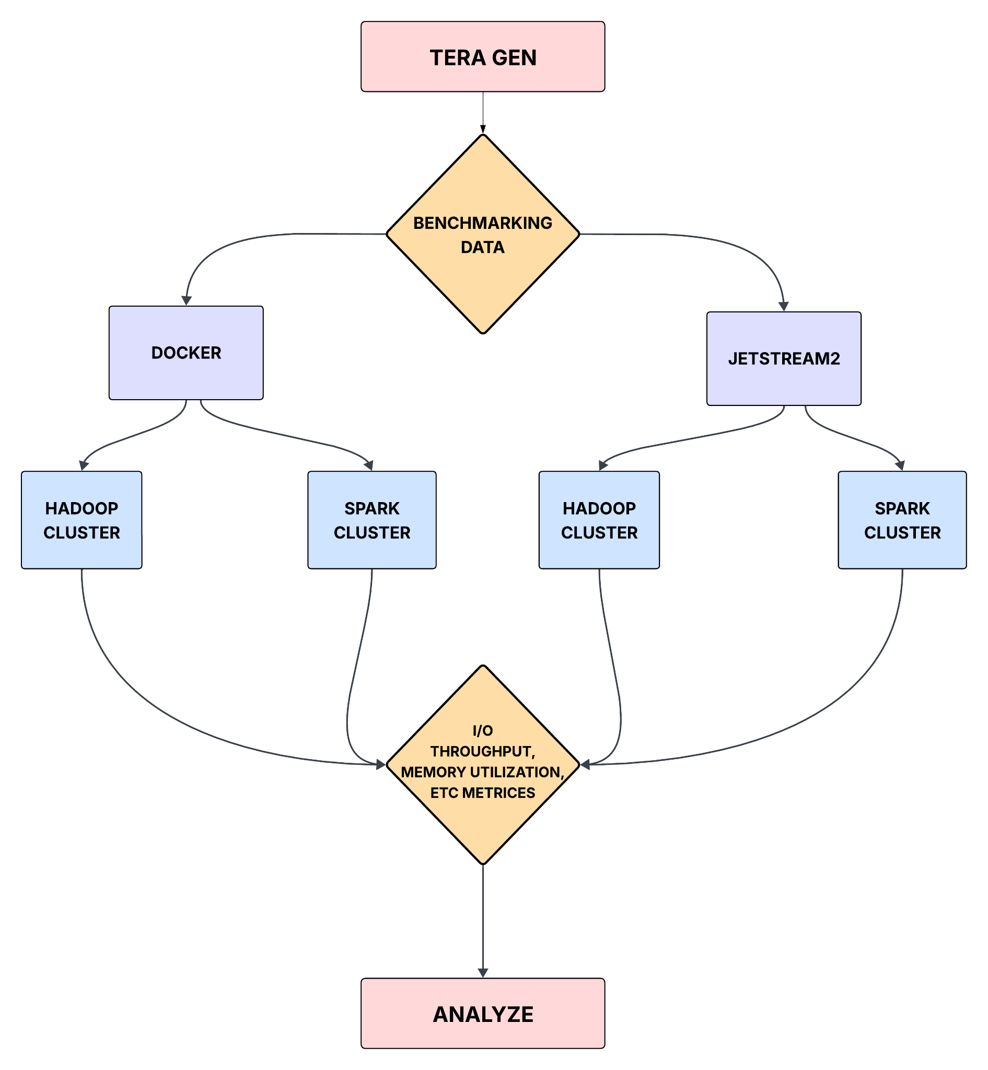
Experiment Settings
Cloud Computing Frameworks
Apache Hadoop 3.4.0
Apache Spark 3.4.1
Cloud Computing Platforms
Jetstream 2
Docker
Benchmarking Task
Terasort
Builtin-in Hadoop
Implemented via PySpark on Spark
1~6 worker nodes in both settings
Jetstream instances: 2GB RAM
Docker containers: 2GB RAM
Notes:
“Let’s start by discussing the first experimental platform we used: the Docker-simulated cluster.”
“In this setup, we used a single physical machine to host multiple Hadoop and Spark nodes, each running inside a Docker container.”
“These containers communicated over Docker’s bridge network, which simulates a local area network using NAT routing. It’s fast for prototyping, but it introduces extra hops compared to real hardware.”
“For storage, we attached Docker volumes to each container. These volumes use an overlay filesystem, where disk writes go through multiple layers. While convenient, this layering introduces extra I/O overhead — especially problematic for Hadoop, which depends heavily on disk throughput.”
“The key advantage of this platform is cost-efficiency. It’s very lightweight to spin up, and it allows easy reproducibility, especially for small-scale development and testing.”
“However, the tradeoff is that Docker’s virtualization layers — particularly for network and storage — distort performance characteristics. Latency is higher, bandwidth is lower, and disk I/O is not as fast as with real hardware.”
“As a result, Docker is an excellent tool for rapid experimentation, but its results must be interpreted carefully when predicting production behavior.”
“In short, our Docker cluster was a practical, low-cost environment — but not a perfect reflection of real-world system performance, especially for I/O-intensive tasks like Hadoop TeraSort.”

Slide 5
Definition of Key Metrics
Wall time (↓) = Total job duration
Shuffle Throughput (↑)= Shuffle Data/ Wall Time
Measures data exchange speed between workers
I/O Throughput (↑)= I/O Volume/Wall Time
Reflects disk performance
Aggregation Resource Utilization (↓)=Total vCore usage (CPU * Wall Time)
Reflects total CPU consumption
Memory Utilization (↓)= Avg memory usage per worker

Slide 6
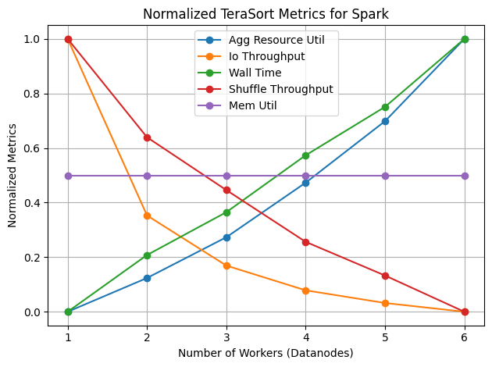
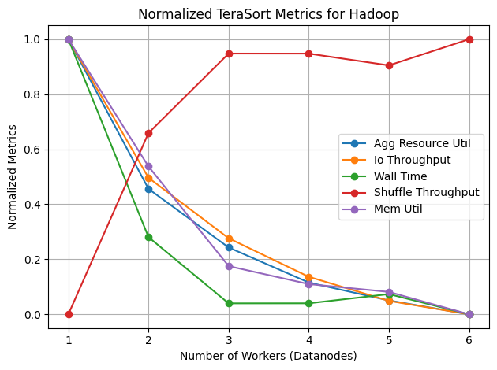
Results: Spark vs Hadoop on Docker
Spark suffers from wall time increasing
Hadoop shows wall time improvement up to 3 workers
I/O Throughput decreases in both cases, suggesting data fragmentation or contention
Shuffle throughput declines in Spark but improves in Hadoop
Memory usage is constant in Spark, but improves steadily in Hadoop

Slide 7
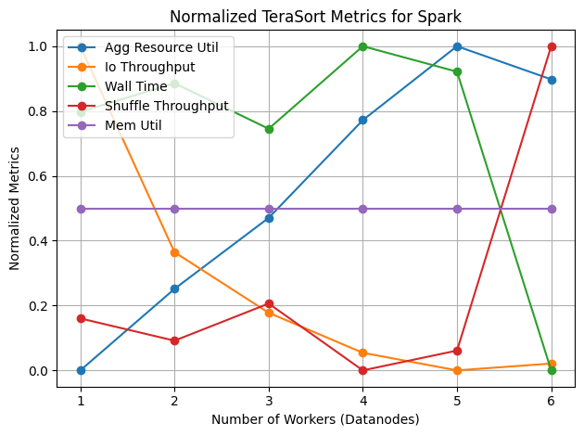
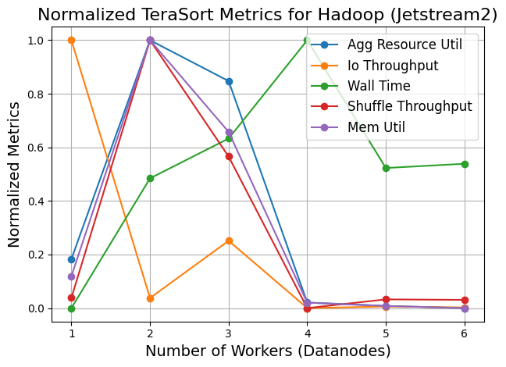
Results: Spark vs Hadoop on Jetstream 2
Spark shows relatively stable wall time and consistent usage
Hadoop suffers from extreme instability, with metrics collapsing after 3 workers
Jetstream 2 amplifies infrastructure bottlenecks, making Spark more resilient in shuffle intensive tasks

Slide 8
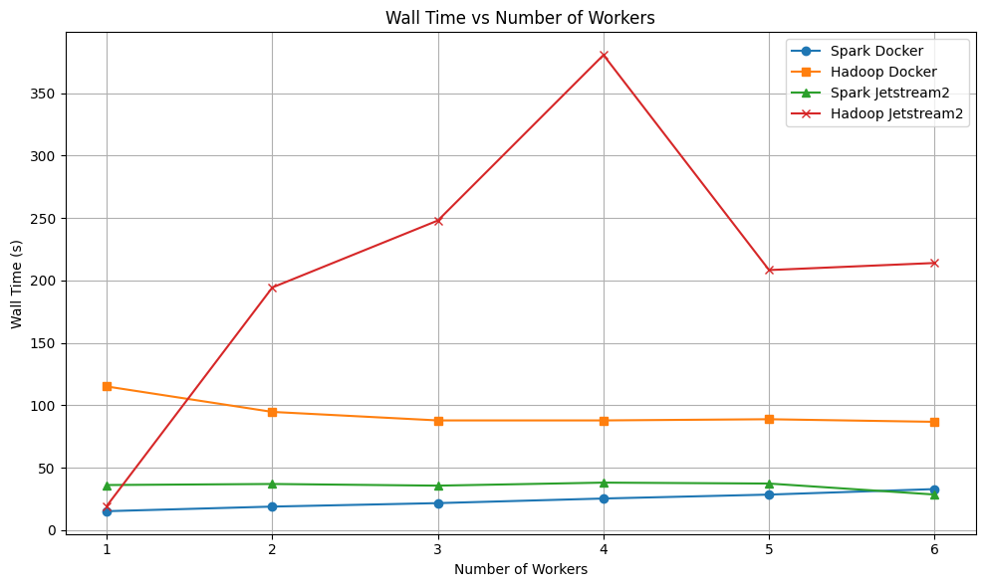
Analysis: Wall Time vs Num of Workers
Add workers DOES NOT guarantee faster performance
Infrastructure bottlenecks hinders real-world scaling
Docker simulations mask scaling issues, but Jetstream 2 reveals them
Hadoop is very fragile under cloud resource contention
Notes:
Spark on Docker: Wall time increases slightly with more workers, but not significantly
Hadoop on Docker: Wall time decreases slightly, showing minor benefit, but limited by I/O bottlenecks
Spark on Jetstream 2: Wall time is nearly flat, cloud resources contention
Hadoop on Jetstream 2: Wall time highly unstable, peaking at 4 workers, revealing bottlenecks

Slide 9
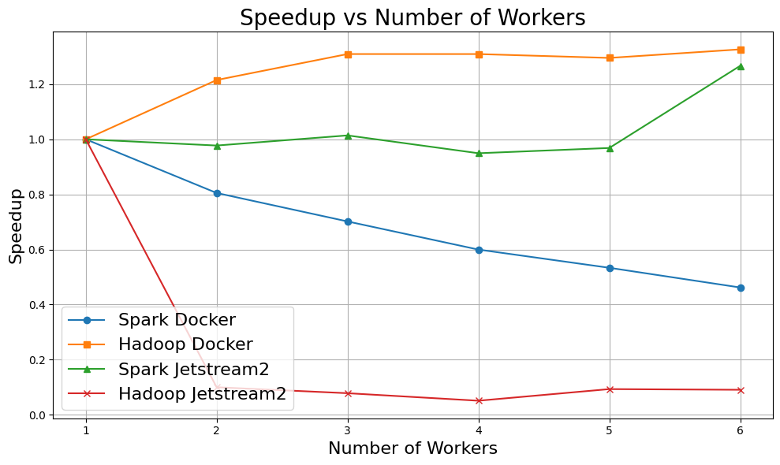
Analysis: Speedup vs Num of Workers
Speedup = (Wall Time at 1 worker)/(Wall Time at N workers)
Evaluates scalability. Ideal speedup is linear
Spark Docker: fails to scale up due to container nature
Hadoop Docker: gains minor speedup but limited by I/O
Spark on Jetstream 2: shows cloud contention cancels scaling
Hadoop on Jetstream 2: speedup almost 0

Slide 10
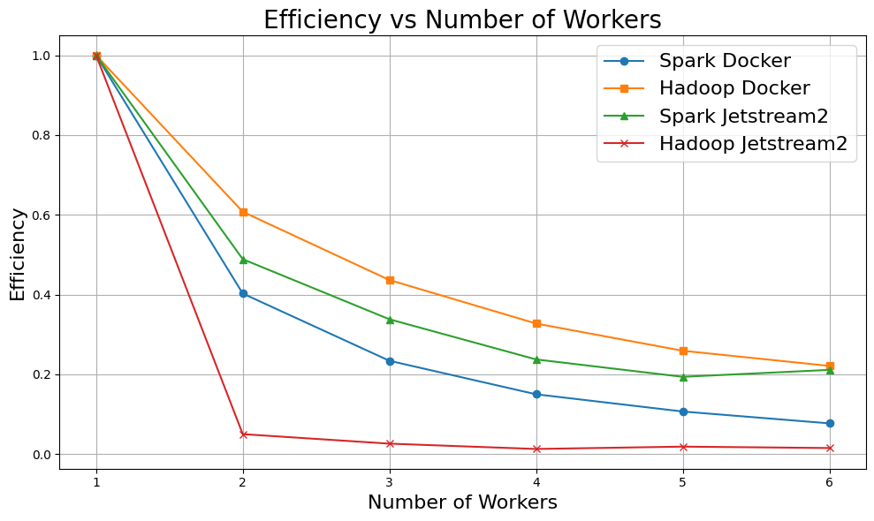
Analysis: Parallel Efficiency vs Num of Workers
Parall. Efficiency = Speedup(N)/N
Ideal efficiency = 1 (perfect scaling)
Describes utilization quality
Adding more workers leads to sharp efficiency loss
All applications and platforms receive efficiency loss

Slide 11
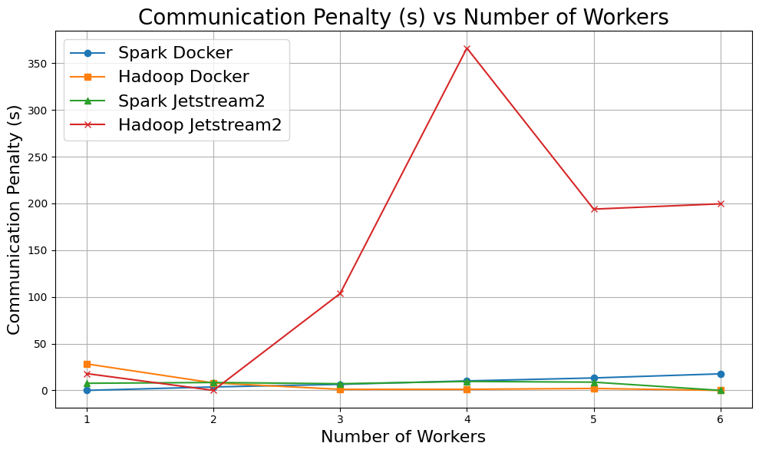
Analysis: Communication Penalty vs Num. of Workers
CommPenalty = WallTime(N) * (1 - Sh.Thruput(N)/MaxSh.Thruput(N))
Evaluates how much communication overhead in the system
Critical for shuffle-intensive workloads like TeraSort
Spark Docker: CommPenalty grows
Hadoop Docker, Spark Jetsteam 2: low CommPenalty
Hadoop Jetstream 2: explodes in CommPenalty, due to Network/Disk bound

Slide 12
Conclusions
We extensively benchmarked 4 cloud platforms in shuffle heavy task (TeraSort)
Get the best scenarios where the platforms most suitably apply
For our task, Hadoop Docker has the best performance
Comprehensive theoretical analysis is in the final report
Platform | Behavior | Major Bottleneck | Conclusion
Hadoop docker | Stable wall time, low CommPenalty | I/O Throughput | Best for small-scale sorting on local clusters
Spark Jetstream 2 | Flat wall time, low CommPenalty | Cloud contention | Acceptable for batch jobs
Spark Docker | Wall time decays, CommPenalty grows | Network Shuffle Congestion | Good for simple deployment
Hadoop Jetstream 2 | Highly unstable | Disk and network congestion | Not recommended without heavy tuning

Slide 13
Team Contributions:
Chi Zhang: Conducted experiments and analysis on Docker-based clusters, including benchmarking Hadoop and Spark performance locally.
Krishna Priya: Led the setup and execution of Hadoop and Spark clusters on Jetstream2 cloud, ensuring successful job runs in the virtual environment.
Sanjana Reddy Nenturi: Performed detailed analysis of Hadoop and Spark on Jetstream2, extracting and interpreting key metrics from log outputs.
Sai Shriya Surla: Led deeper analysis involving speedup, parallel efficiency, and communication penalty across all platforms.

Slide 14
Thanks!

